Slide 1


VISVESESVARAYA TECHNOLOGICAL UNIVERSITY BELAGAVI-590018
GHOUSIA COLLEGE OF ENGINEERING
Phase 2
Presentation On
AI POWERED FITNESS ASSISTANT
Department of Information Science and Engineering
UNDER THE GUIDANCE OF : PRESENTED BY:
Dr.DILSHAD BEGUM Ajay kumar HN : 1GC22IS003
HOD Dept of CSE Chirag H : 1GC22IS010
Prajwal banakar : 1GC22IS022

Slide 2
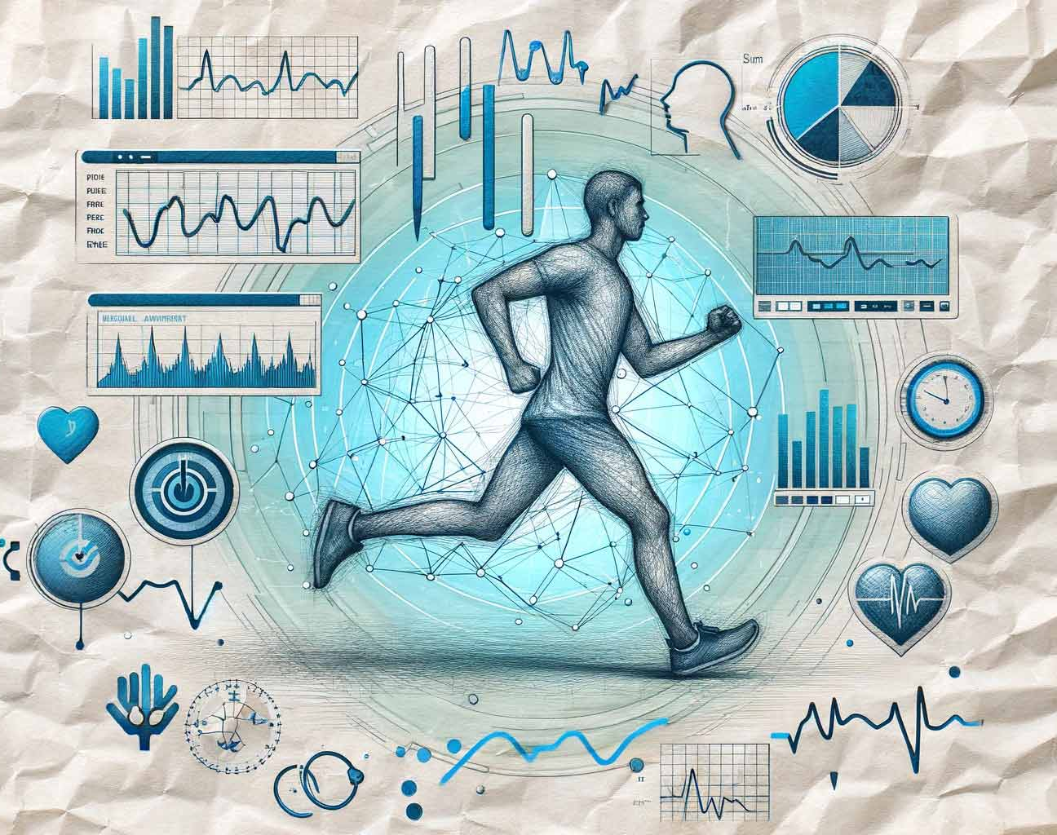
AI POWERED FITNESS ASSISTANT

Slide 3
CONTENTS
Introduction
Literature review
Existing system
Problem Statement
Proposed system
Objectives
Proposed Methodology
System Architecture
Technologies Used
Future Enhancements
Conclusion
References

Slide 4
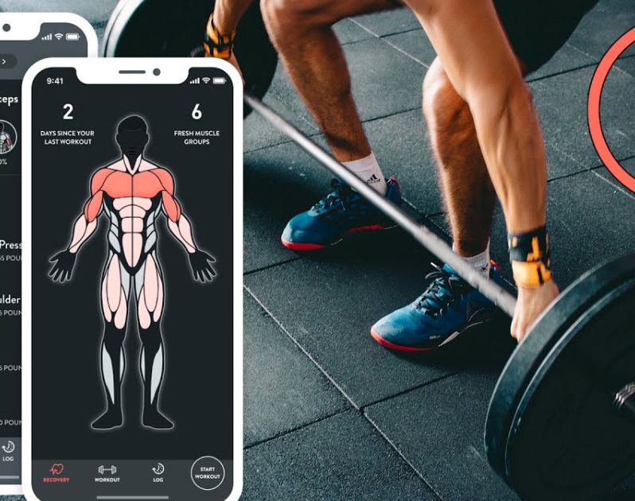
Introduction
In recent years, the intersection of technology and wellness has given rise to a new generation of digital fitness tools.
Among these, AI-powered fitness apps have emerged as transformative platforms that leverage artificial intelligence to provide personalized, adaptive, and intelligent workout experiences.

Slide 5
Literature review
Title | Authors | Year | Summary
Personalized Fitness with AI | Jain et al | 2020 | Developed an AI model to personalize workouts based on user profiles
Real-Time Posture Correction using Computer Vision | Kim & Lee | 2020 | Used pose estimation to provide live feedback during exercises
AI Health Monitoring via Wearables | Wang et al | 2021 | Integrated sensors and AI to monitor heart rate and activity levels
virtual AI Coaches for Motivation | Smith et a | 2021 | Used NLP to create virtual coaches that motivate and guide users
Injury Prediction with Machine Learning | Zhang et al | 2022 | Predicted risk of overtraining based on activity

Slide 6
AI-Based Diet and Exercise Recommendation System | Gupta et al | 2022 | Combined fitness tracking with AI-generated diet
Voice-Based Fitness Coaching Assistant | Sharma & Roy | 2022 | Implemented a voice-interactive AI for guiding fitness routines hands-free
Deep Learning for Pose Estimation in Home Workouts | Lee & Tran | 2022 | Used deep neural networks for tracking
AI Chatbots in Mental and Physical Wellness | Desai et al | 2023 | Studied AI bots supporting both emotional
AI for Adaptive Recovery Scheduling | Mehta & Banerjee | 2024 | Designed AI to recommend rest periods based on fatigue prediction

Slide 7
AI-Powered Gamification in Fitness Apps | Narang et al | 2024 | Integrated AI with gamification to improve user motivation
Emotion-Aware AI in Fitness Tracking | Huang & Pate | 2024 | Used sentiment analysis from voice/text to adapt workout intensity
Reinforcement Learning for Dynamic Workout Plan | Bose et al | 2024 | Applied RL to adapt workouts based on continuous user feedback.
Cross-Cultural AI Fitness Assistant | Khan & Silva | 2024 | Designed culturally adaptive AI workouts and nutrition guidance
Hybrid AI-IoT Framework for Remote Fitness Coaching | Ali et al | 2024 | Integrated sensors, AI, and cloud services for live coaching experiences.

Slide 8
Existing system
Manual and Generic Approaches Most fitness tracking systems rely on manual input or generic rule-based recommendations. They lack personalization and adaptability, often leading to limited motivation and effectiveness.
One-Size-Fits-All Plans Traditional apps provide fixed workout and diet plans that do not adapt based on user progress, behavior, or health conditions.
This project explores AI-based fitness personalization AI allows dynamic tracking and learning from real-time user data such as heart rate, movement, calories, and sleep patterns.

Slide 9
PROBLEM STATEMENT
Manual creation of fitness and diet plans is tedious. Static plans do not adapt to user progress. Most apps lack AI-driven personalization. Our system solves this with a smart, scalable solution.
Users find it difficult to integrate dietary preferences and physical constraints into pre-existing systems.

Slide 10
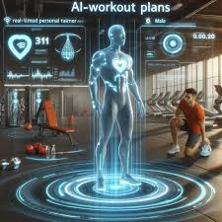
Proposed system
The proposed system aims to revolutionize personal fitness by integrating Artificial Intelligence to offer smart, adaptive fitness planning.
•AI-powered assistant for workout and diet. •Built with Node.js and TypeScript. •Uses Gorq (Lama 3 model) for generating content. •Responsive UI with React.js and tailwind CSS •Users receive and export customized fitness plans.

Slide 11
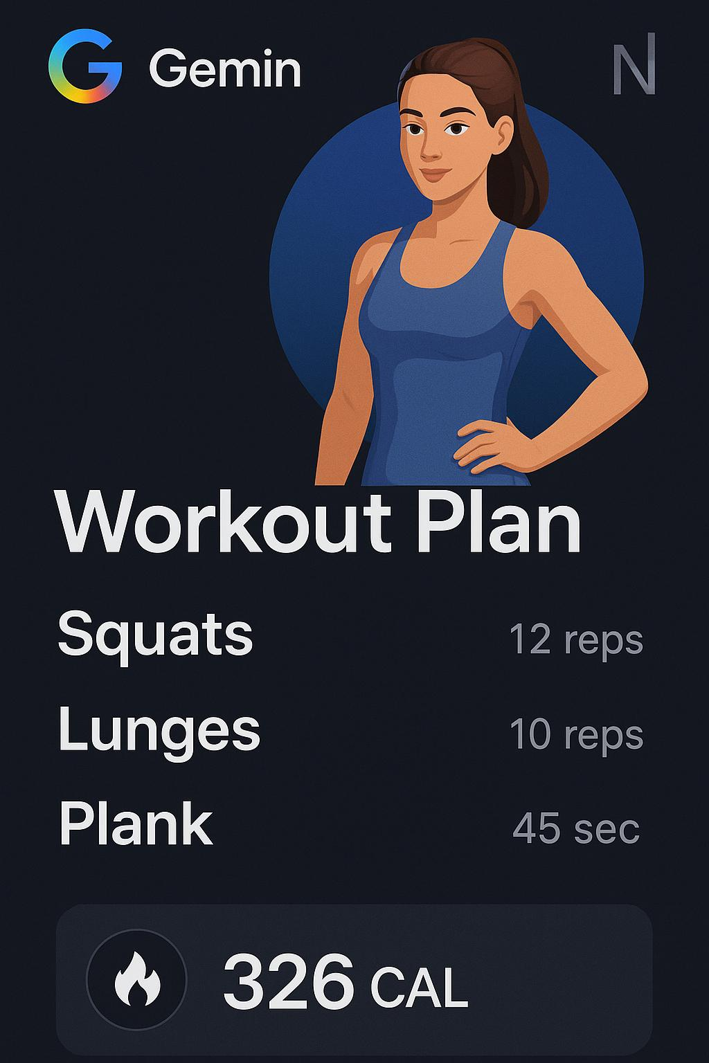
Objectives
•To provide personalized workout plans using AI based on user goals and data.
•Gather user-specific input for fitness goals. •Generate Diet and Workout plans using AI. •Display dynamic results with UI components. •Allow PDF download of plans. •Find their nearby Gym’s and Yoga classes.
•To use AI chatbots for 24/7 virtual fitness coaching and motivation.

Slide 12
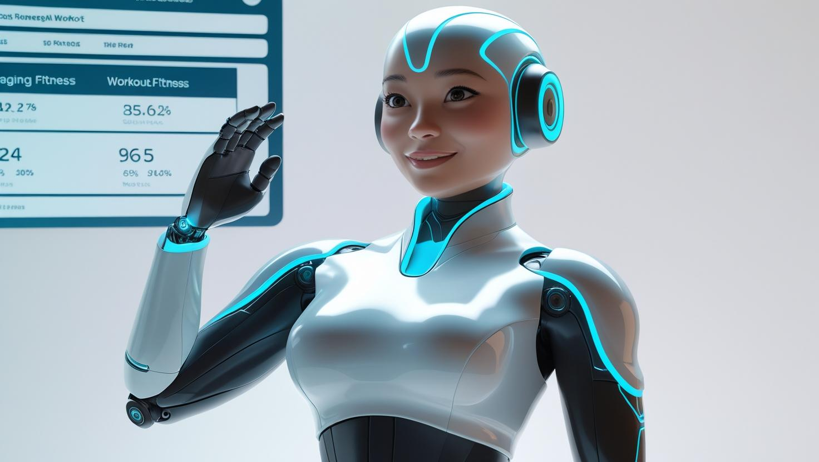
Proposed Methodology
Analyze user needs and define features
User logs in and enters fitness data. Data passed to Gorq API. AI processes and generates routines. Plan displayed using React components. User can view and export to PDF.

Slide 13
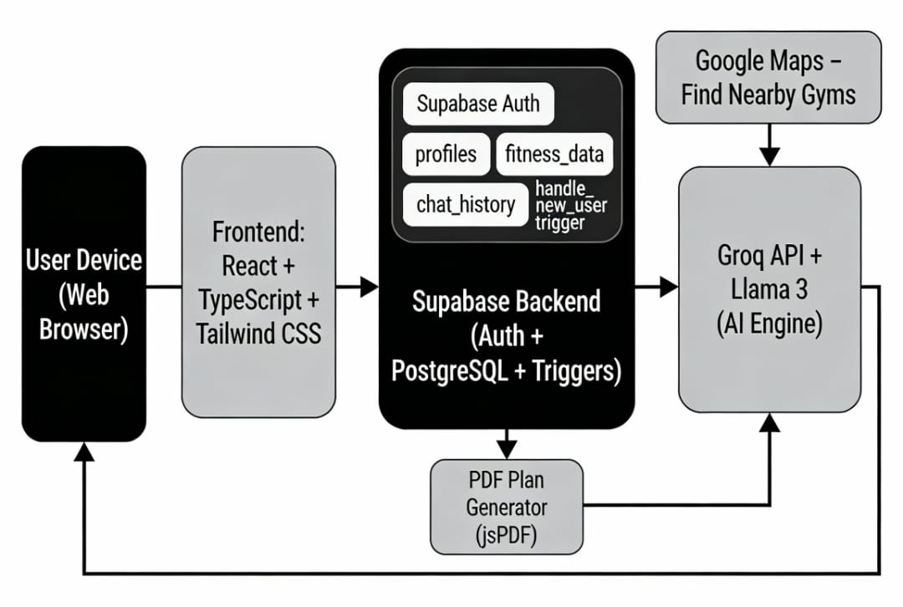
System Archicture

Slide 14




Technologies used
Frontend: React, Typescript, Vite, Tailwind CSS
Backend : Superbase, Node.js Authentication : Superbase Auth AI Engine: Gorq (Lama 3) PDF Export: jsPDF / html2pdf
Database :Superbase (PostgreSQL)

Slide 15
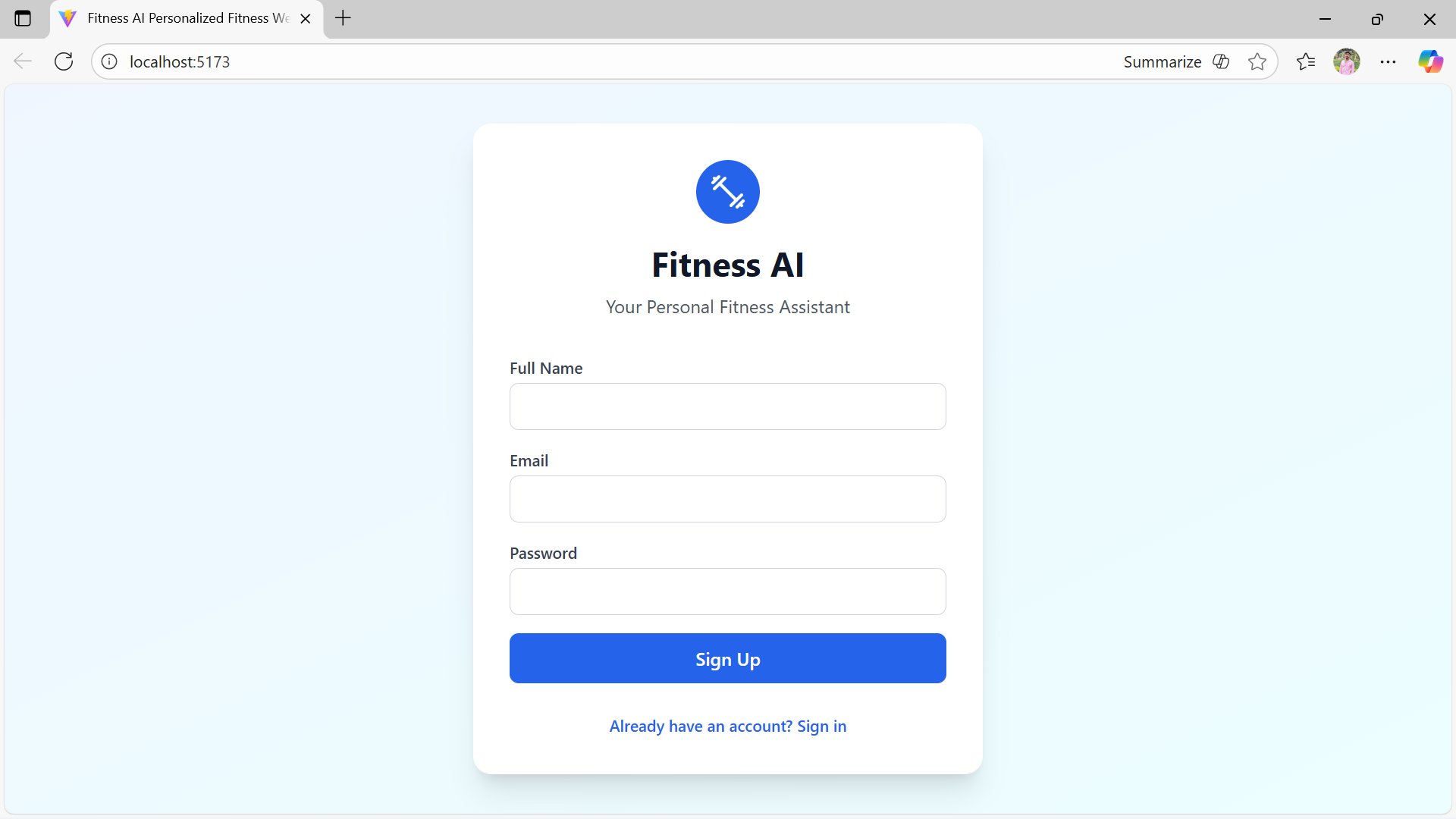

Slide 16
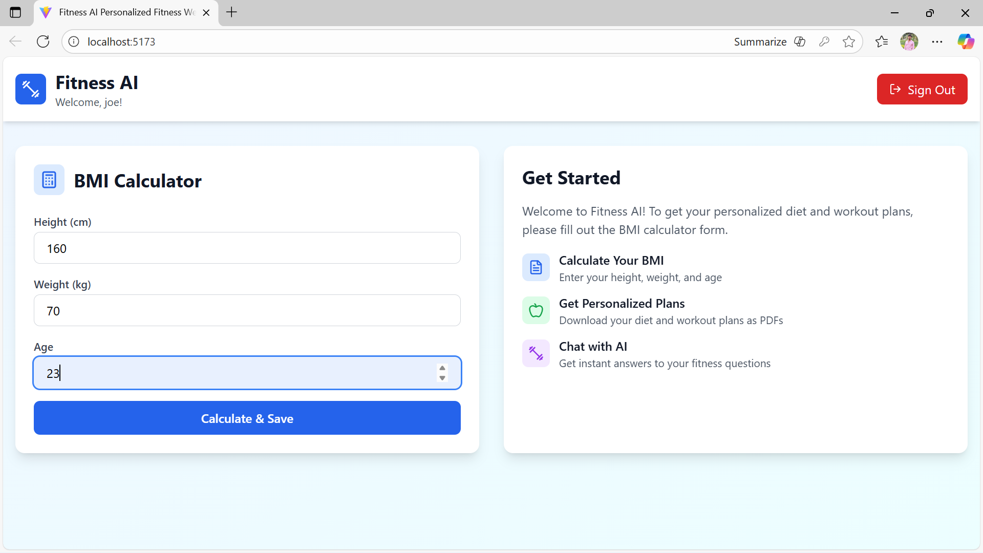

Slide 17
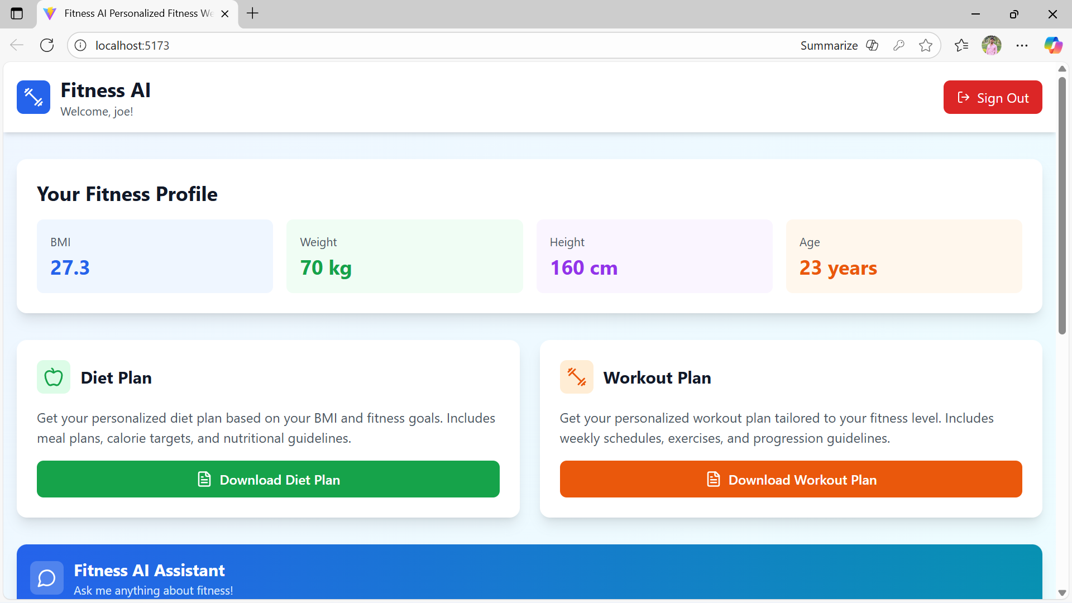

Slide 18
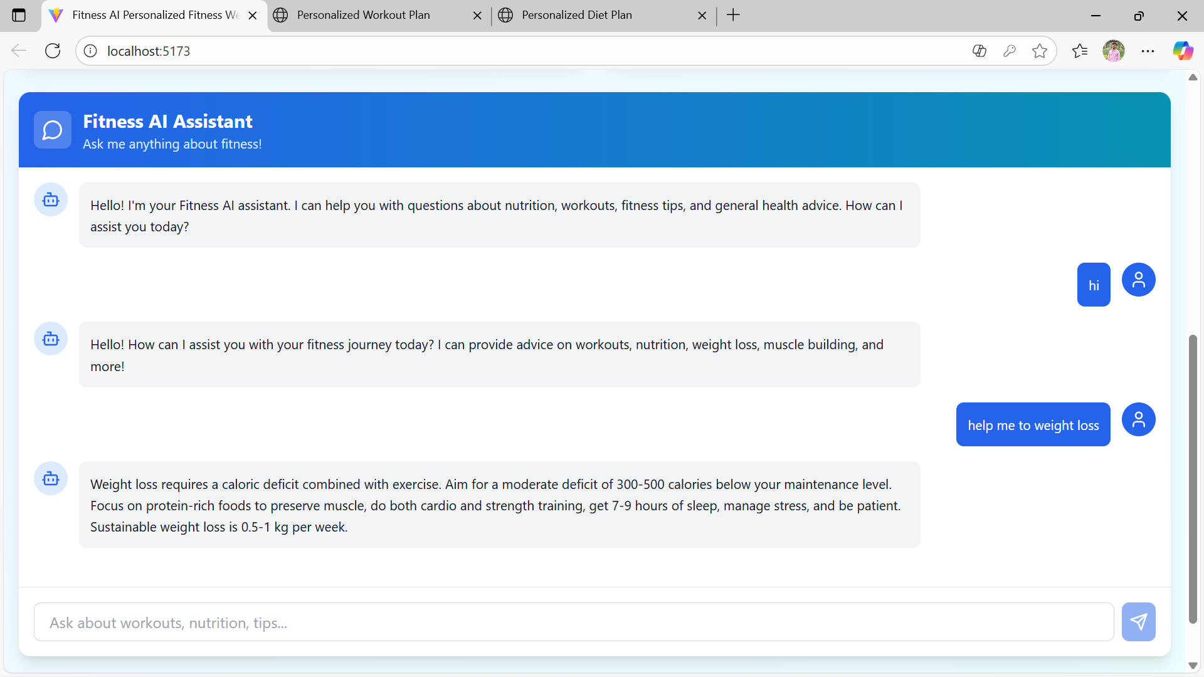

Slide 19
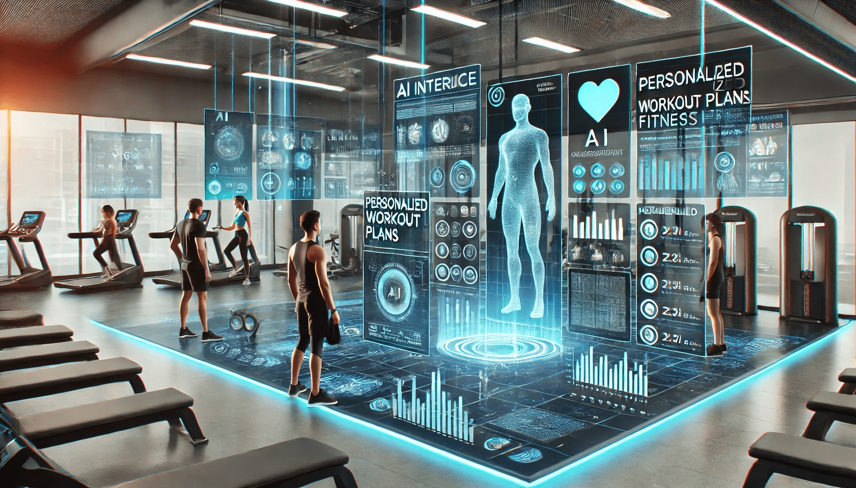
Future Enhancements
Integration with wearable devices (Fitbit). AI-based fitness chatbot assistant. Progress tracking and analytics dashboard.
Multilingual support for global accessibility. Community and social sharing features.
Voice assistant integration for hands-free interaction.

Slide 20
CONCLUSION
The AI-Powered Fitness Advisor effectively bridges the gap between user goals and smart, data-driven fitness planning. Leveraging Gemini AI and Next.js ensures scalability, personalization, and performance. With enhanced UI/UX and future-ready enhancements, this solution sets a benchmark in intelligent fitness applications. It provides an accessible, adaptive, and efficient tool for health-conscious users globally.

Slide 21
References
FitMate AI-Powered Fitness Companion: Revolutionizing Health and Wellness through Technology, Mukesh Patidar Department of Computer Science & Engineering Parul Institute of Engineering and Technology, (Parul University) Vadodara (Gujarat).2024
Google AI Research, OpenAI, IEEE Xplore, ACM Digital Library, Springer, Elsevier Y. M. Yee, “FitBot: A ChatGPT Mobile Application-Based Fitness Tracker for Elderly Users,” IEEE, 2024. IEEE Sensors Journal, IEEE Access, IEEE Transactions on Biomedical Engineering B. Kumar, V.,, “AI-Driven Fitness Coach: Webcam-based Form Correction and Rep Counting for Optimized Workouts,” IEEE, 2024. ReactConf & ShadCN Documentation

Slide 22
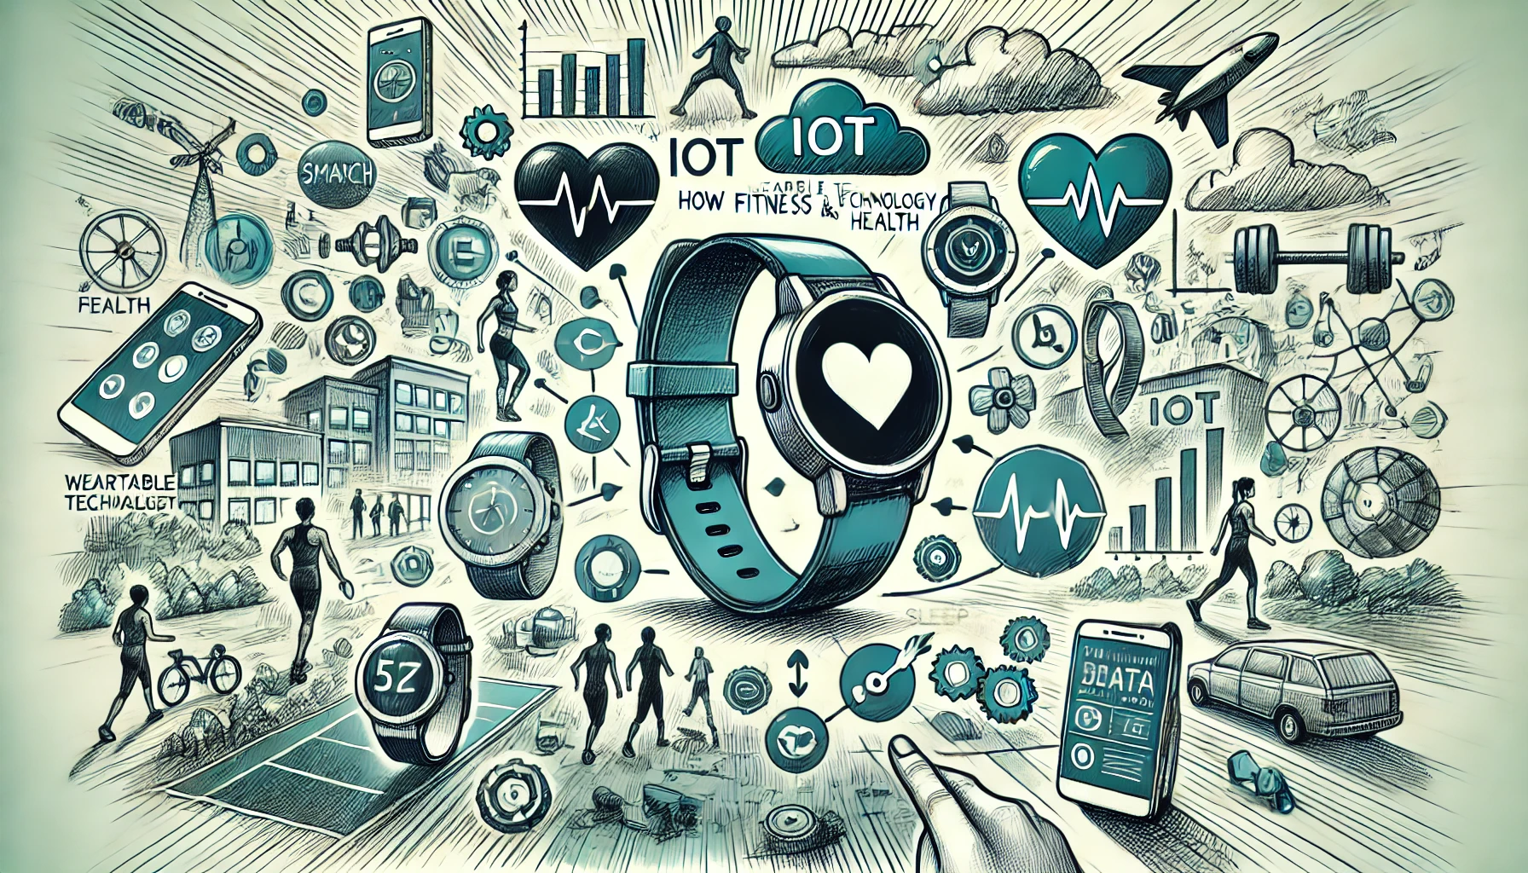
THANK YOU
SWEAT NOW
SHINE LATER

